Slide 1
DeepSI: Interactive Deep Learning for Semantic Interaction
Authors: Yali Bian and Chris North
Paper URL: https://dl.acm.org/doi/10.1145/3397481.3450670
Conference: 26th International Conference on Intelligent User Interfaces (IUI '21)
Md Samshad Rahman
samshad@dal.ca
B00968344

Slide 2
Introduction
Key Focus:
Enhancing visual analytics through semantic interaction.
Integrating deep learning (BERT) into human-in-the-loop pipelines.
Problem Statement:
Traditional Semantic Interaction (SI) systems rely on fixed, pre-trained representations.
Limited adaptability to user-specific tasks and intents.
Inefficient user feedback loops for clustering and sensemaking.

Slide 3
Datasets Overview
Dataset | Domain | Task Description | Labels/Clusters | Data Size
CORD-19 | COVID-19 Research | Group articles by risk factors | 4 (Cancer, Kidney, etc.) | 1,056,660 entries
SST (Sentiment Treebank) | Sentiment Analysis | Classify movie reviews into sentiment | 2 (Positive, Negative) | ~1,800 reviews
Vispubdata | Academic Papers | Cluster IEEE VIS papers by conference type | 3 (InfoVis, SciVis, VAST) | ~1,400 papers
20 Newsgroups | Text Categorization | Classify news articles by topics | 4 (Autos, Sports, etc.) | ~2,400 articles

Slide 4
Framework Overview
Pre-trained BERT embeddings as initial input.
Users refine visualizations through feedback.
Fine-tune BERT using user-driven interaction.
Generate 2D visualization from BERT embeddings.
Adjust BERT representations via user feedback (fine-tuning)

Slide 5
Proposed Solution and Objective
DeepSIfinetune: A framework to improve SI by fine-tuning BERT representations through human feedback.
Interactive learning that dynamically adapts to user needs.
Task-specific, user-driven data representations.
Enhanced accuracy and efficiency in SI systems.
Application to real-world datasets (e.g., COVID-19 research).

Slide 6
How It Works
Initial Data Representation:
Uses pre-trained BERT embeddings to initialize data representations.
Data is visualized in a scatterplot based on these embeddings using MDS (Multidimensional Scaling).
User Interaction:
Users adjust data points by clustering them visually (e.g., dragging articles into groups).
Model Fine-Tuning:
User feedback triggers backpropagation to fine-tune BERT representations dynamically.
This generates task-specific representations that reflect user-defined relationships.
Feedback Loop:
Updated model generates new, refined visualizations, better aligned with user goals.
Comparison to Baseline (DeepSIvanilla):
DeepSIfinetune embeds fine-tuning directly into the interaction pipeline, while DeepSIvanilla relies on static pre-trained embeddings, limiting adaptability.

Slide 7
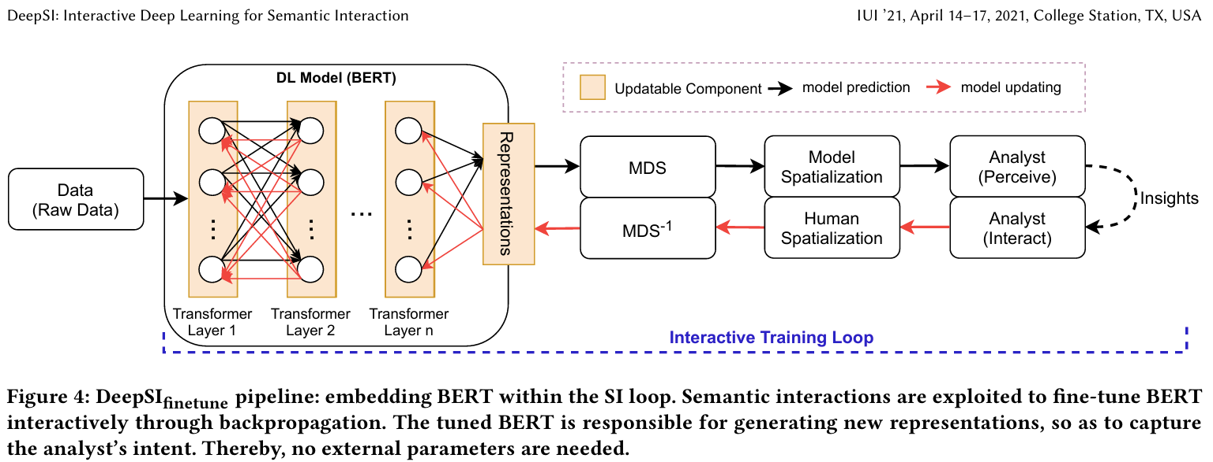

Slide 8
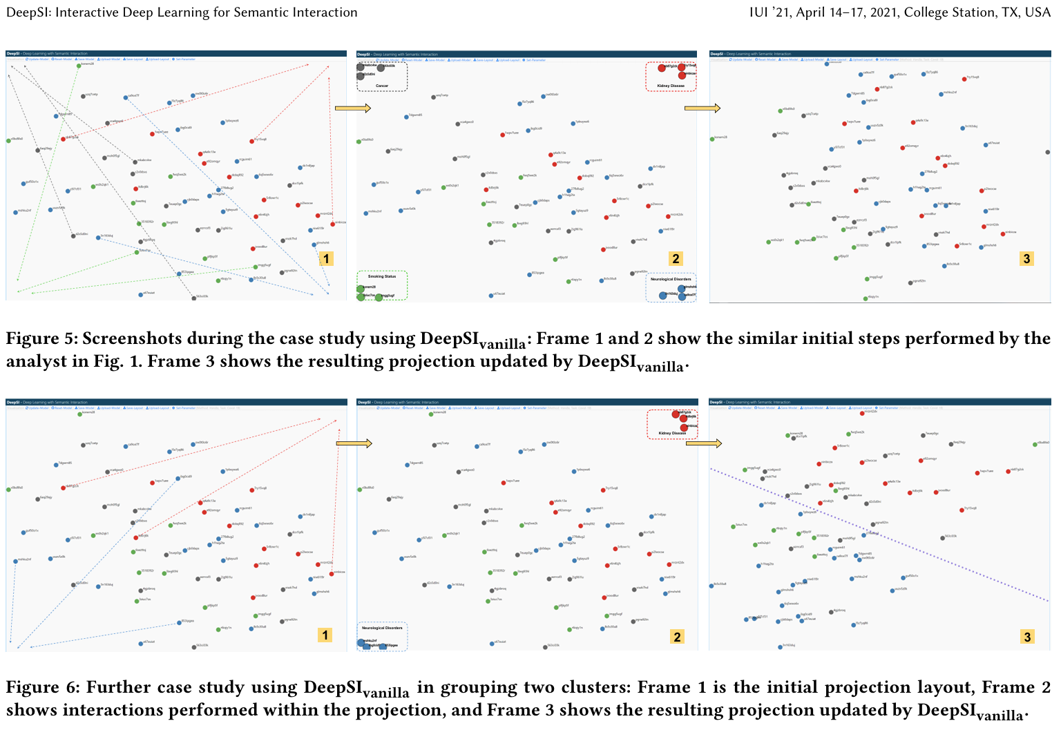

Slide 9
Why is This Problem Relevant?
Increasing complexity and volume of data require intuitive, interactive systems for sensemaking.
Static models (e.g., pre-trained features) fail to capture user-specific and task-specific nuances.
Efficient feedback loops reduce cognitive and interactional burden.
Adapts to diverse domains with minimal user effort.

Slide 10
Bottlenecks and Limitations
Category | Limitation
Model Dependence | Relies heavily on the quality of pretrained BERT embeddings.
Computational Complexity | Fine-tuning BERT and MDS scaling are resource-intensive, especially for large datasets.
Interpretability | Lack of transparency in how internal model updates align with user feedback.
Scalability | Challenges in adapting to very large datasets and non-textual data domains.
User Dependency | Relies on high-quality user feedback; effectiveness depends on user expertise.

Slide 11
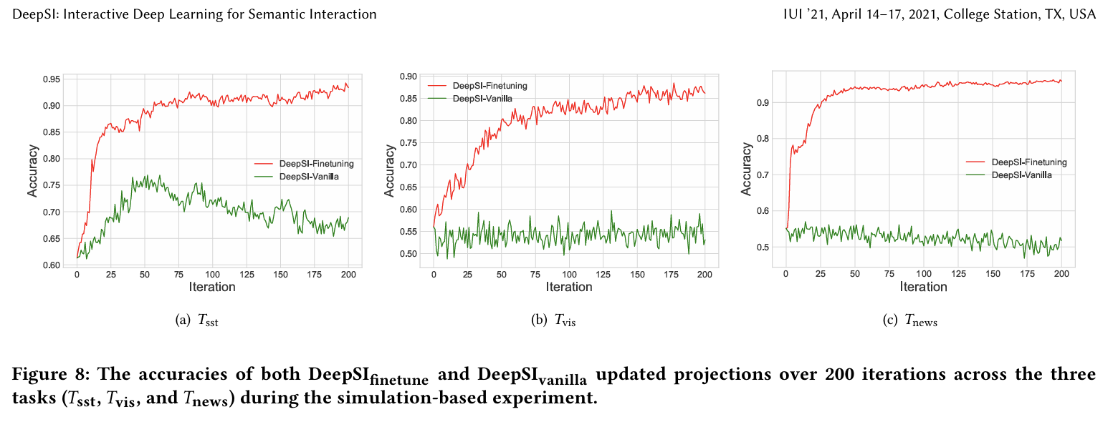
Justification of Accuracy

Slide 12
Thank you
Q&A

